Slide 2
Our theory of change is that interactions build relationships, relationships are the backbone of community, and together as a community, we can ensure our collective future is economically, socially, and environmentally just.

Slide 3
01
Past

Slide 4
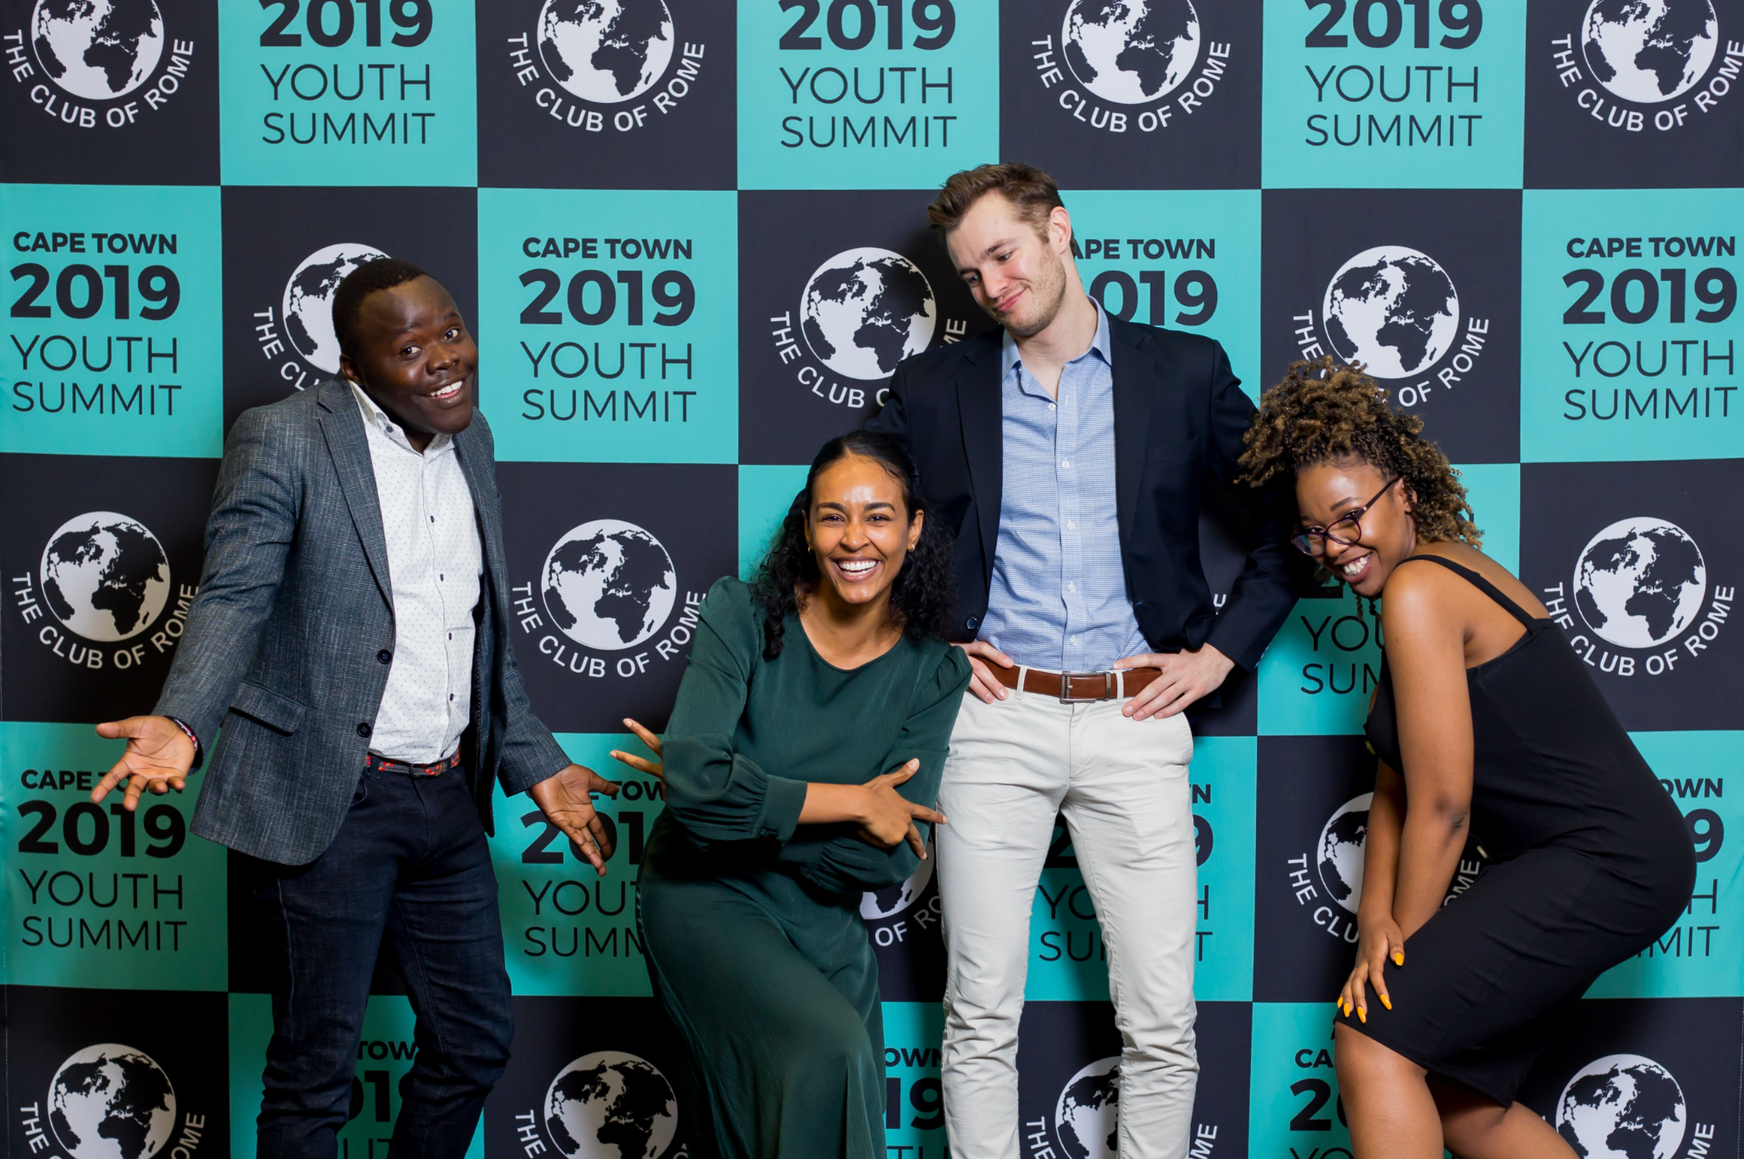
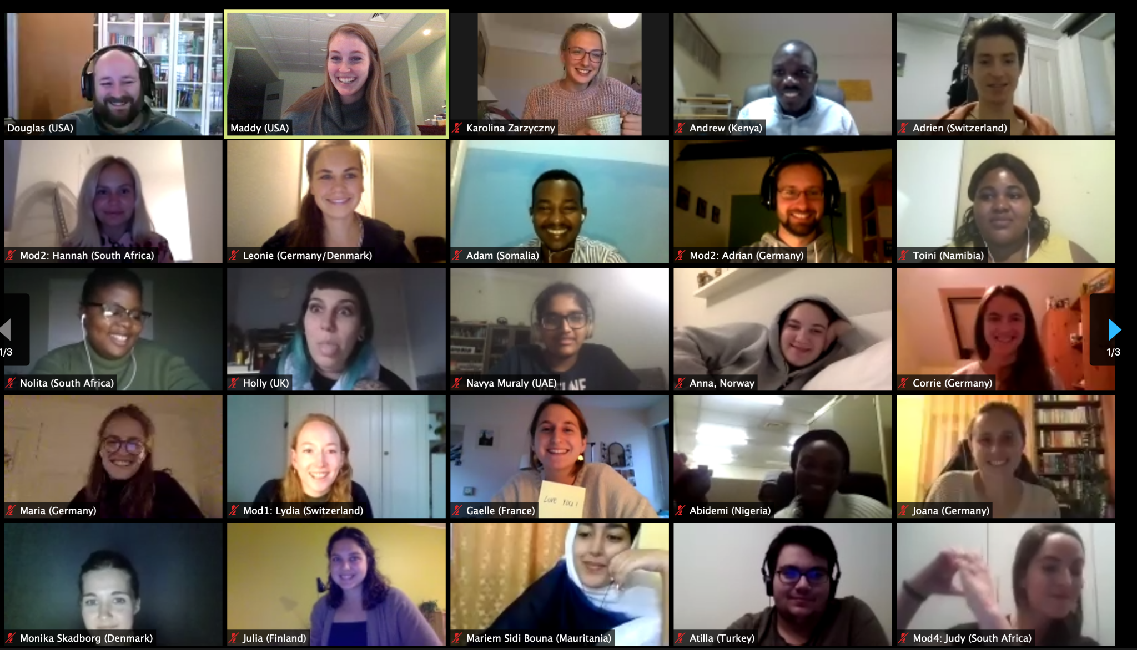
History
Youth Summit 2019
Global Youth Summit 2020
Organized: ReimagineSA
Hosted: South Africa
Organized: Maddy + Doug
Hosted: Virtually
Building off this success, we created the...

Slide 5
What We Learned from the Summit
ALL youth need a voice
Too many youth-focused programs select the “top 1%” of youth to participate
There needs to be lasting support
Youth must be integrated into conversations
For youth to take meaningful action, they need to have sustained mentorship and spaces for collaboration
Many spaces seek the “token” youth voice, whereas youth should be seen as valuable contributors

Slide 6
Two ‘Pathways’ of Youth Engagement Programs
Structured, focus on top representation of youth, highly-educated, privileged, focus on skill development and capacity building
Example:
UN Youth Delegate Program
Grassroots, stand on the streets/protesting activism, little focus on developing skills, anyone can be involved, traditional “activism” emphasis
Example:
Fridays for Future

Slide 7
02
Piloting

Slide 8
4 Successful Pilot Elements
Fail Fast, & Often
Community building activities for Associate Members;
Listening Sessions;
Online Magazine; and
Psychological Mastery Program
Since the launch of The 50 Percent (formally Global Youth Engagement Program) in 2020, our youth team has launched a series of pilots, yielding four successful program elements:

Slide 9
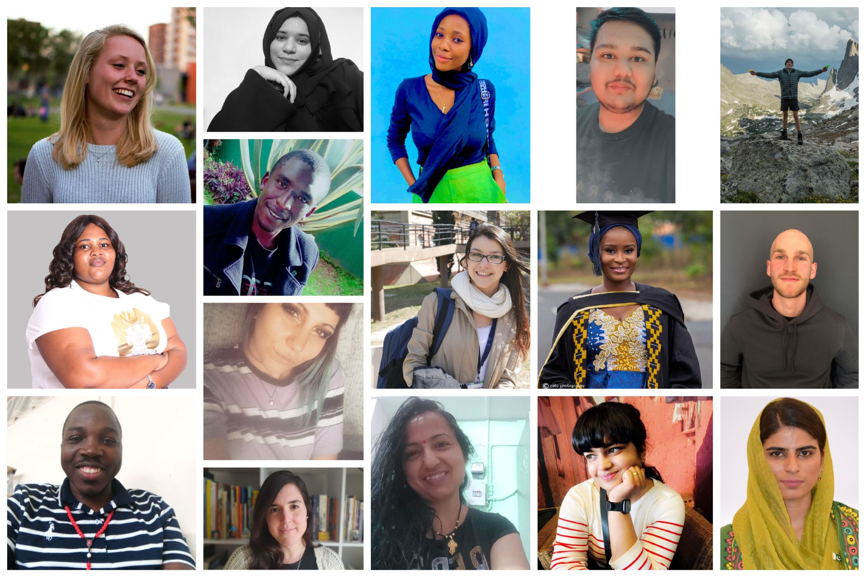

Slide 10
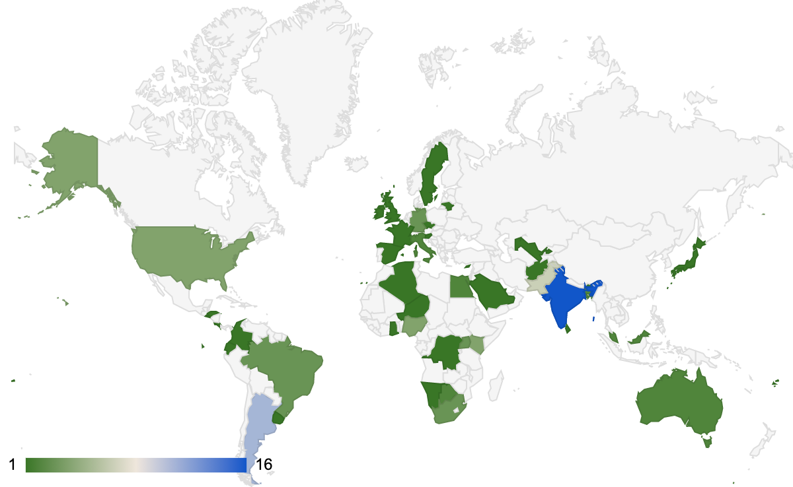
Map of Current Associates
Dark Green: Less Associates
Dark Blue: More Associates

Slide 11
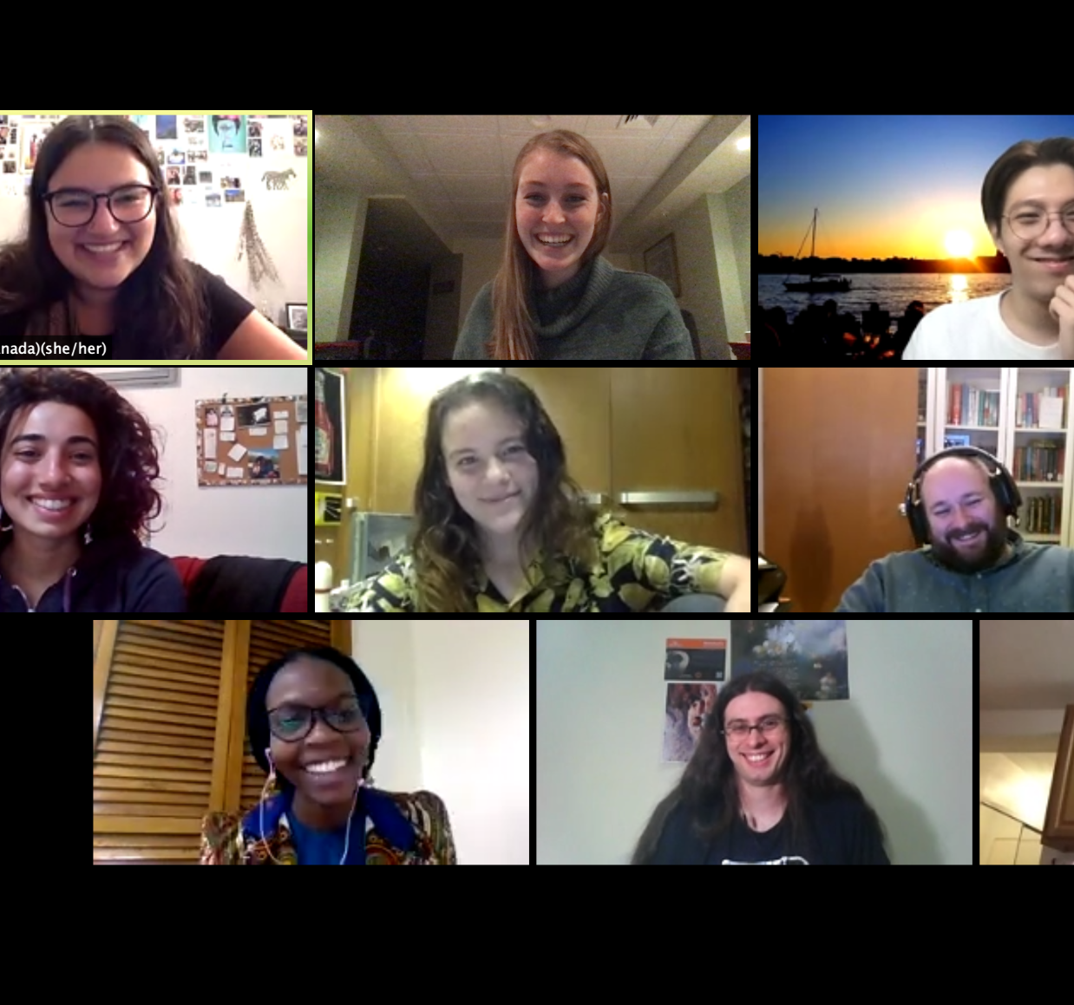
Listening Sessions
Associates host virtual convenings in their local areas to hear the challenges and the hopes that each young person has in their community, as well as the skills & resources they need to tackle challenges

Slide 12
What are Listening Sessions?
Listening sessions to allow us to sit across the (often virtual) table from others, learn from them (capture our data per se) while also beginning to develop the moderator-to-group, peer-to-peer (intergroup) interpersonal relationship.
These sessions are comprised of ~10 youth with an Associate facilitating the group.
Goals
Build Community Locally
Learn to Enable Change

Slide 13
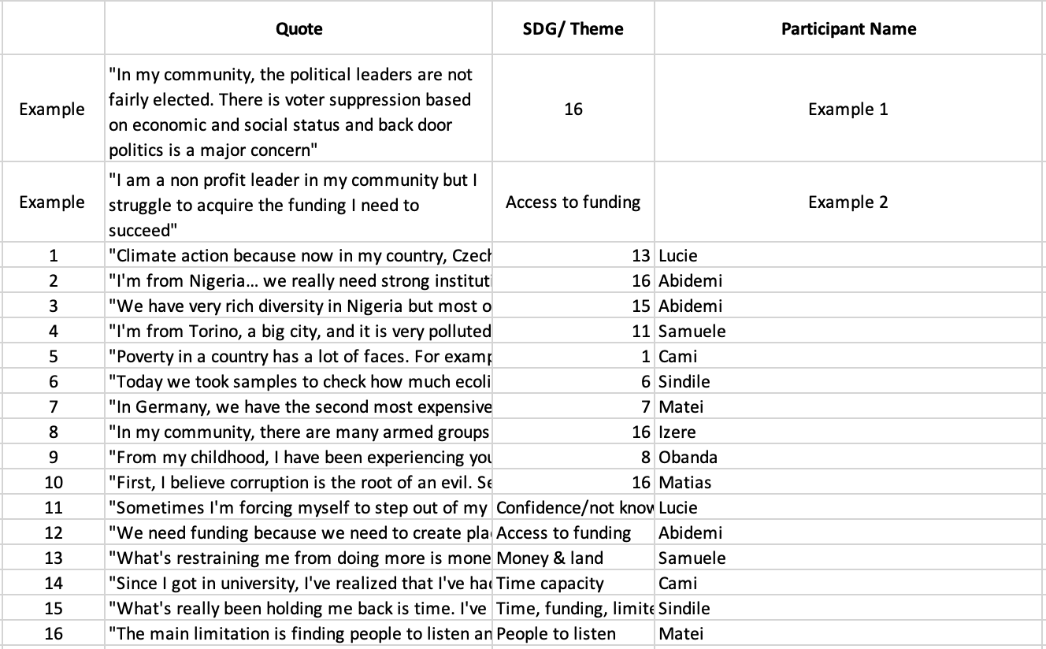
Data Collection
By the Numbers
All quotes collected from the Listening Sessions will go into a searchable data repository, as well as a report. This information will be made accessible to anyone to help inform youth perspectives locally + globally.
Total Listening Sessions: 52
Total Number of Youth Engaged in Listening Sessions: 414
Count of Listening Session Quotes Recorded: 602

Slide 14
Questions Asked in Listening Sessions
Which of the Sustainable Development Goals is most concerning to you and your community? Why did you choose this SDG? Can you share a specific story or example from your experiences or your community that highlights this SDG?
What actions are you or your community taking towards sustainability goals? What skills have you learned or do you believe are necessary as a youth leader? And what obstacles are holding you or youth in your community back from taking further action?

Slide 15
Quote from Listening Session
“I had a personal experience 5 or 6 years ago. When we were not around, the looters would break into the house and steal ACs and TVs and everything so they can go and make some money. This is because of the inability of jobs. Or should I say the inability of good jobs. Even if there were good jobs, these people would not qualify. Why don’t they qualify is because they couldn't go to good schools or institutions. This is down to poverty”
—Youth participant from Ghana

Slide 16
Quote from Listening Session
"In the last year or so, there's a small town nearby called Andalgala, that's neighbor to mine, in which a community of Indigenous people are fighting against a mining company. This place is the only place in Argentina where they're extracting coal right now. The mining company is actually contaminating the whole area, destroying the forests and land. The Indigenous people are fighting the mining company but they aren't being sided with the government or any institution so the need for peacebuilding and the population being active in this situation is really needed at the moment."
—Youth participant from Argentina

Slide 17
Successful Pilot Programs
Online Magazine
Psychological Mastery
A space for youth to express their thoughts and experiences through storytelling
A space for youth to develop self-awareness, emotional resilience + communication skills

Slide 18
Online Magazine
The Fifty Percent Magazine
Sharing stories that challenge the status-quo
Facilitated discussions and global exchange
Mentorship sessions

Slide 19
Psychological Mastery Training
Addressing potential challenges faced by youth leaders:
Climate trauma
Mental health difficulties - “imposter syndrome”
“Hearing that others faced similar challenges to me, while also hearing about different strategies and approaches that I could adopt made me feel less discouraged and more hopeful going forward. I similarly enjoyed being able to support others in their struggles, feeling proud of myself and connected through shared vulnerability.” Islamiat, Nigeria

Slide 20
03
Future

Slide 21
Future of the Program
Funding
Partnerships
Educational Programming
Creating educational offerings to allow youth to build skills and networks
Developing a sustainable funding stream
Connecting with other organizations to expand efforts

Slide 22
Activities with Club of Rome
Youth Summit During Annual Meeting
Collaboration within the Impact Hubs
Quarterly Intergenerational Dialogues

Slide 23
Contact us + learn more:
https://the50percent.org/
Facebook: The 50 Percent
Instagram: @the50percentglobal
LinkedIn: The 50 Percent
Twitter: @the50percent_

