Slide 1
The thinking behind The Club of Rome
Tapio Ojanen, chair of FiCoR
27.1.2022

Slide 2
What is The Club of Rome?
“The Club of Rome is a platform of diverse thought leaders who identify holistic solutions to complex global issues and promote policy initiatives and action to enable humanity to emerge from multiple planetary emergencies.”

Slide 3
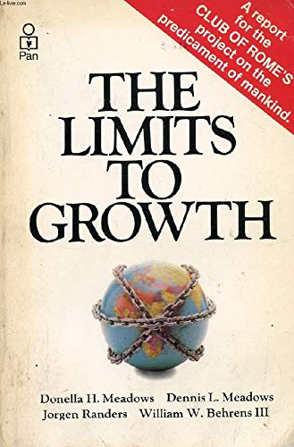
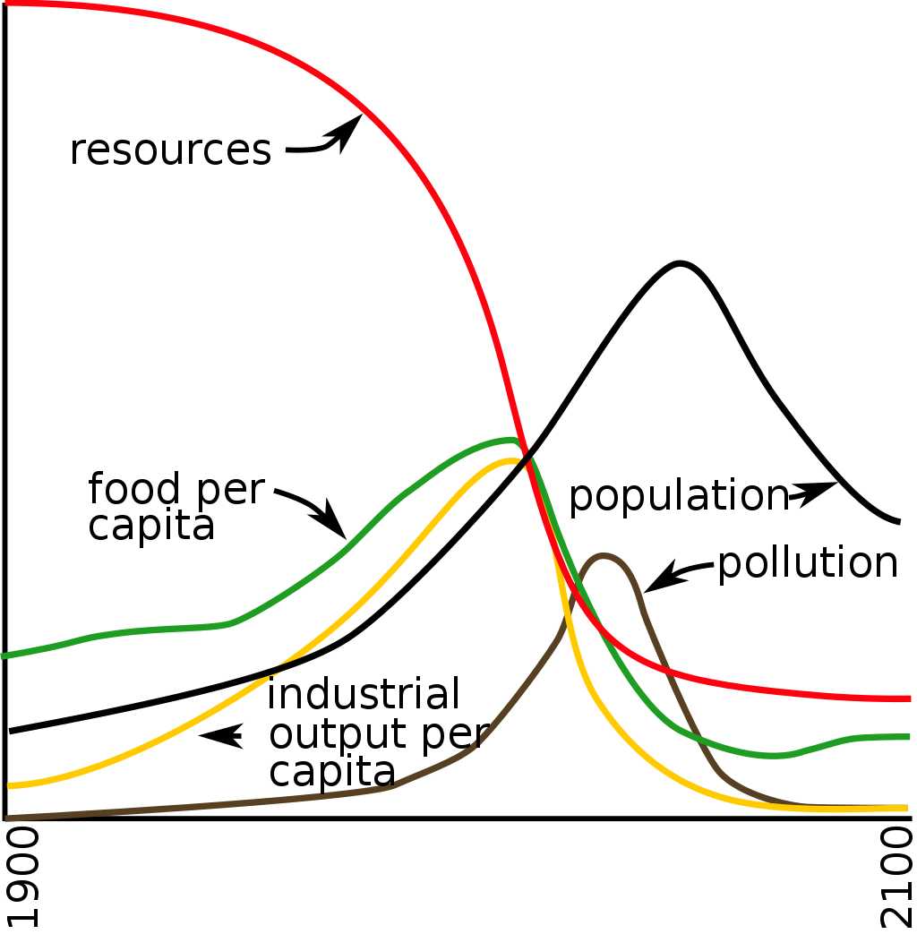
The Limits to Growth 50 year anniversary

Slide 4
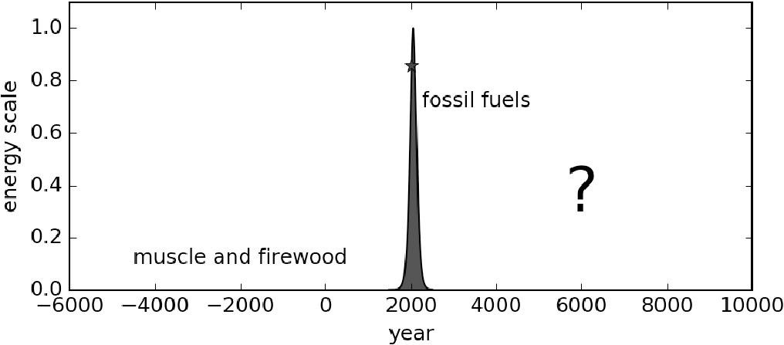
T.W. Murphy et al. 2021: Modernity is incompatible with planetary limits: Developing a PLAN for the future

Slide 5
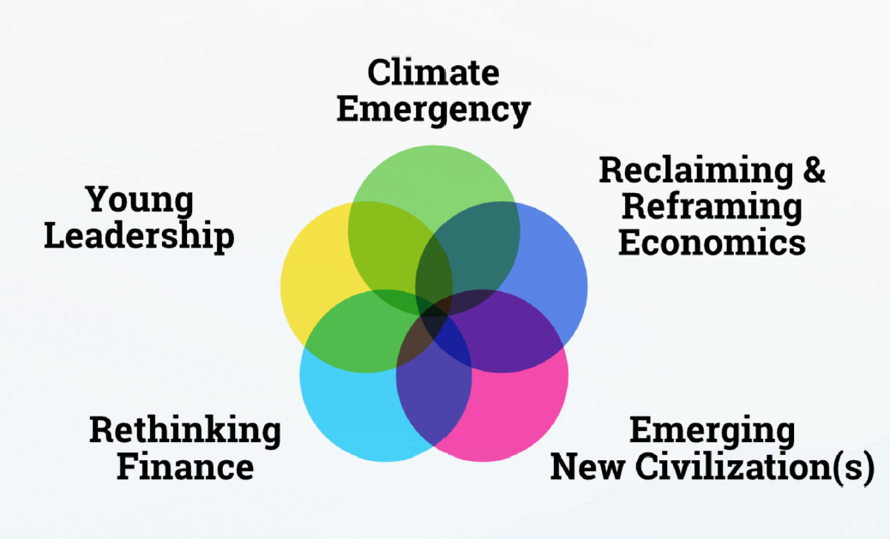
The Club of Rome – Impact Hubs

Slide 6
Reports to The Club of Rome

Slide 7
Thank you!

