Slide 1
The Club of Rome
Presentation to the Finnish Association for the Club of Rome​
23 March 2021

Slide 2
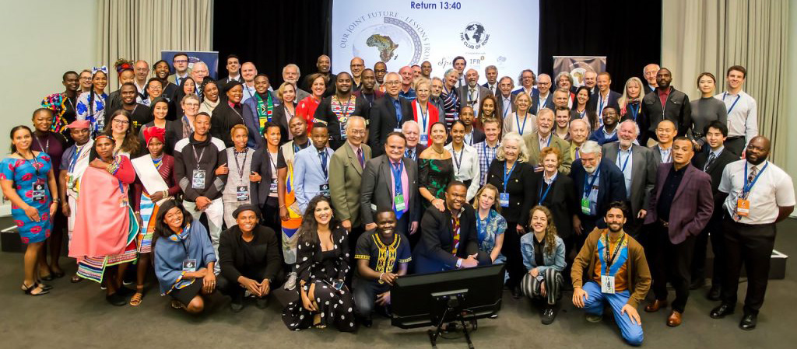
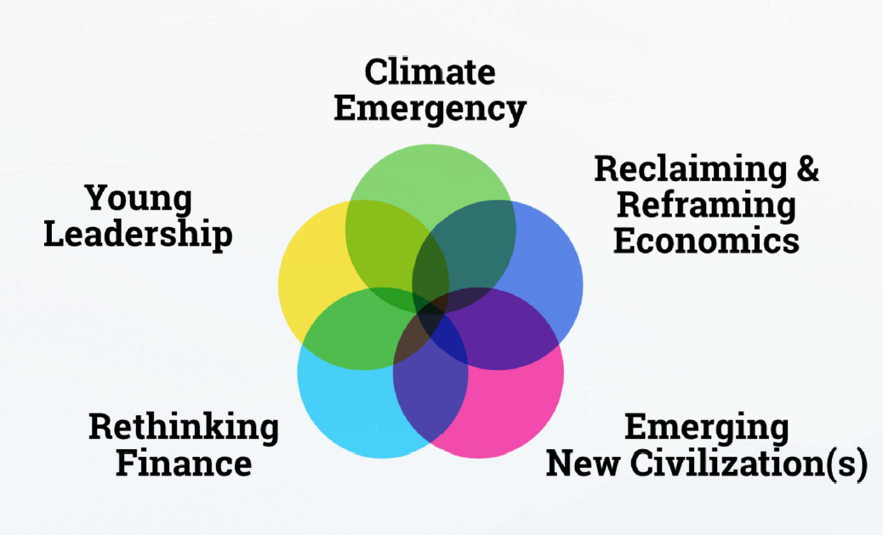
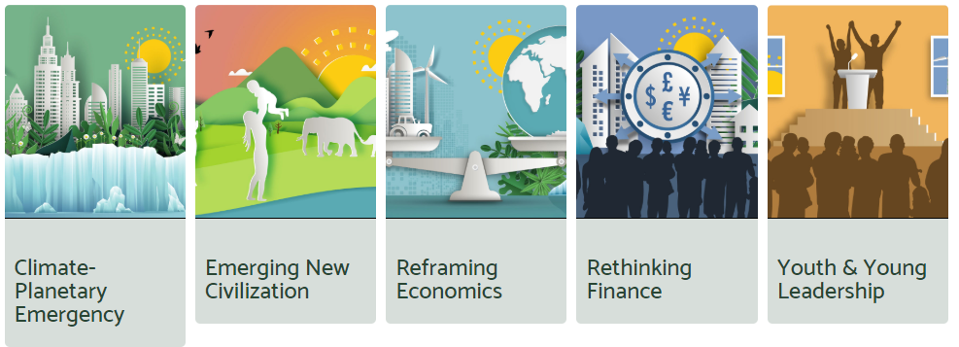
The Club of Rome – Impact Hubs

Slide 3
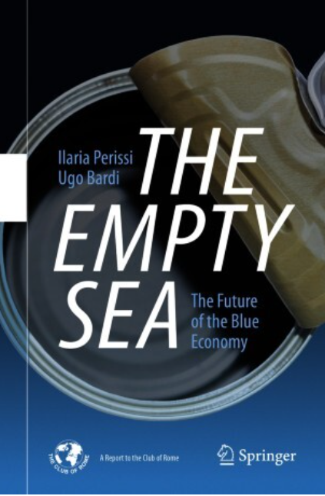
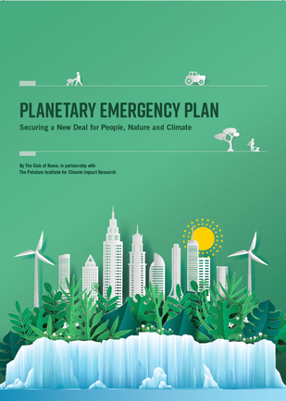
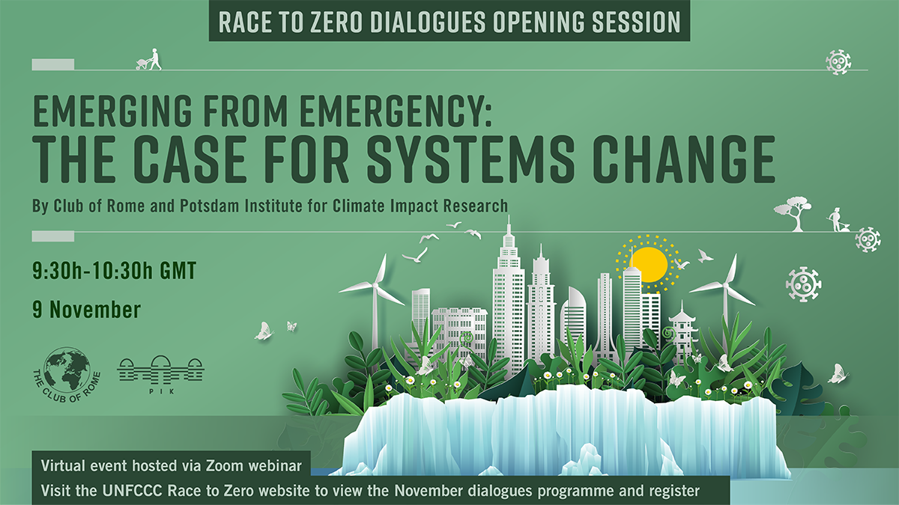
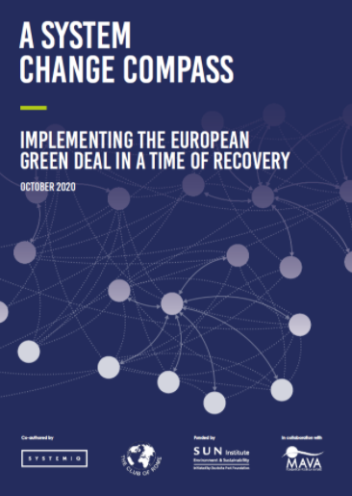
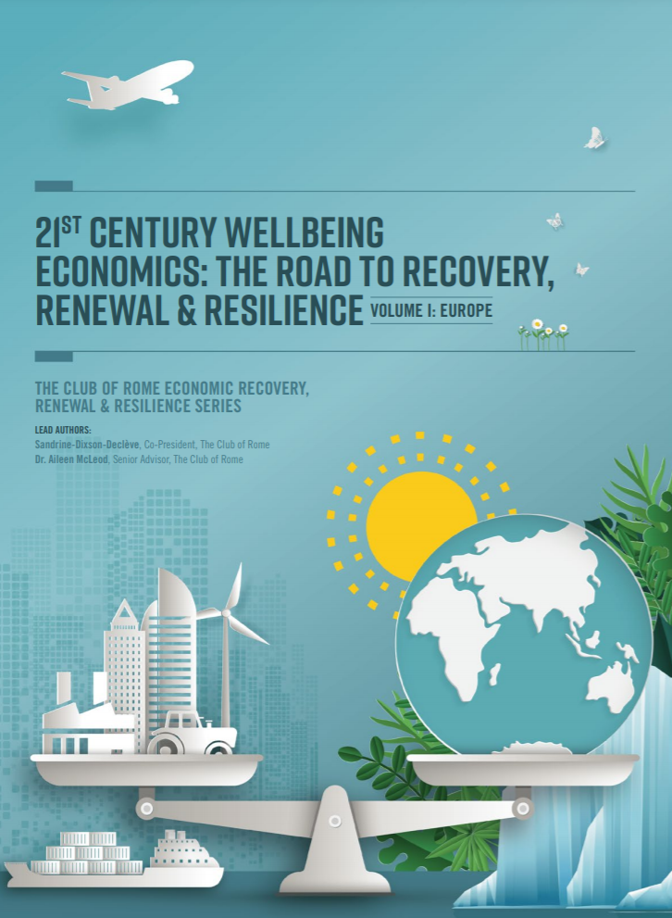
Publications & Events

Slide 4
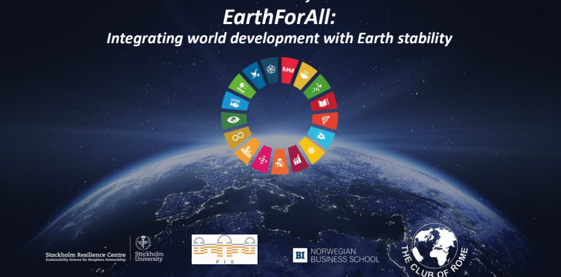

Slide 5
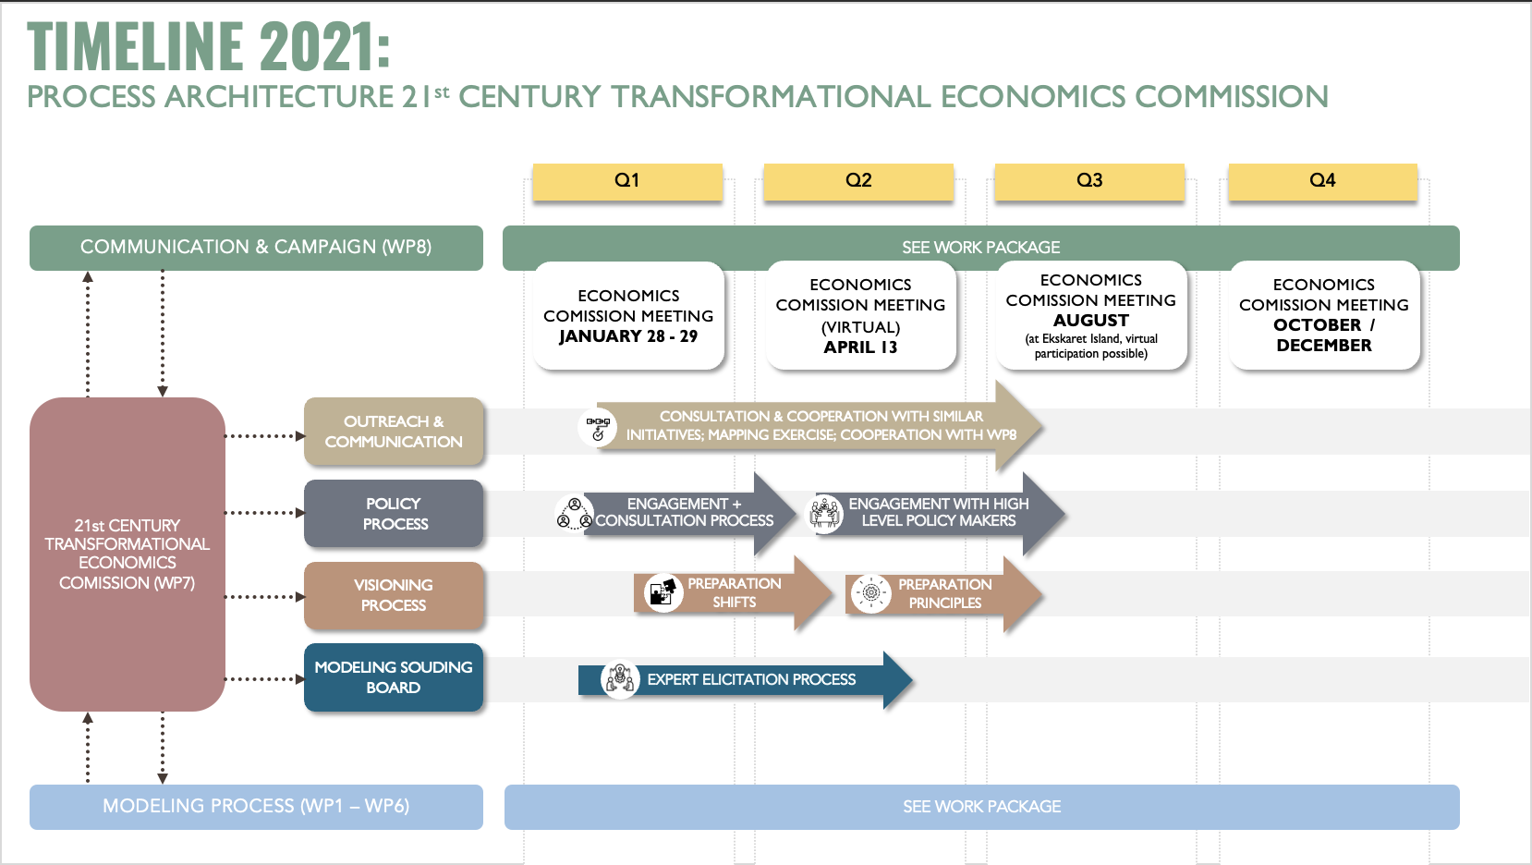

Slide 6
Objectives
Connect transformation pathways to the leading economic thinkers offering new economic models to support human prosperity on a stable planet.
Undertake consultations with economic thinkers and within the sustainability and climate community
Ensure a better understanding of the system shifts needed, the tensions existing and how to best bring decision makers in governments, business as well as citizens on the journey to a new economic model.

Slide 7
Thank You!

