Slide 1
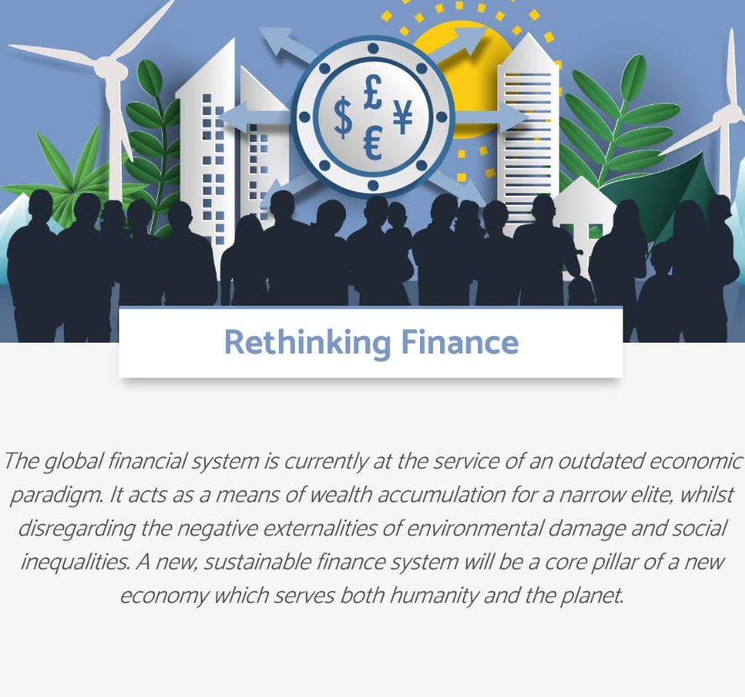
RETHINKING FINANCE
“We need to seize the momentum and accelerate the shifts which are already happening within institutions to move from merely financing change to fundamentally changing finance” - Sandrine Dixson-Declève
““Finance cannot be seen as independent from the system, but rather as an important tool for positive change” - Peter Blom, Triodos Bank and Club of Rome
“Finance must be part of the socio-economic and policy nexus that fuels a shift out of high-carbon, ecosystems destruction and other unsustainable practices.
It is through an integral approach, building on short-term system shifts for long-term impact, where financing change and changing finance go hand-in-hand” – Background note for launch of Impact Hub

Slide 2
CURRENT CONTEXT
European leadership
European Investment Bank fossil phase out
International platform on sustainable finance (Co-led with China)
Leadership by Europe’s Central Banks
Implementation of G20 TCFD – Climate-related Financial Disclosures
European Green Deal Investment Plan + Next GenerationEU
Policy and regulatory initiatives
Europe is spurring a global shift to advance to a sustainable financial system and “taking green financing to the next level*” through its recovery
There is a growing mobilisation of global actors
Network of Central Banks and supervisors
Banking sector - Principles for Responsible Banking and stakeholder model.
Coalition of Finance Ministers for Climate Action
Yet, it is still not enough. For example, G20 investment figures in the energy sector since the beginning of the COVID19 pandemic (updated 30 September 2020):
$207.93 billion supporting fossil fuel energy
$139.99 billion supporting clean energy
*European Commission President von der Leyen’s State of the Union address

Slide 3
ACTIVITIES – A FOCUS ON SYSTEMS CHANGE
Systems change levers
Setting new expectations for public finance (EIB & EU recovery package)
Mobilising cross-system collaboration (through impact space)
Aligning economic models with sustainability (EIB Climate Bank)
Extending policy ambition (e.g. applying do-no-harm principle)
Empowering value-based institutions (GABV)
Revaluating sovereign debt instruments
“Your contribution is immensely valuable and we appreciate the time and effort you’ve taken.” Stephen O’Driscoll – Head of Climate and Environment at the European Investment Bank
“We are excited to collaborate in order to re-evaluate the potential of debt instruments for the resilient recovery” Simon Zadek, Finance 4 Biodiversity
“This is the first time I’ve heard such open and positive remarks from the European Central Bank” Martin Spolc, DG FISMA, European Commission - referring to a Finance Impact Hub Roundtable.
“Thank you deeply, looking forward to receiving further input” MEP Pislaru – Lead Rapporteur in European Parliament on EU’s Recovery instrument

Slide 4
WHAT’S NEXT?
Build on the foundation of our curated, trusted and creative impact space – creating a network of change agents ready shift from financing change to fundamentally changing finance.
Target our efforts on systems change levers necessary for long-term transformational impact.
Expanding beyond Europe to leverage international systems change – replicating processes and exchanging knowledge between Europe and elsewhere.

